Slide 1

StringBuffer in Java

Slide 2
Today’s Agenda
StringBuffer
Built-in methods of StringBuffer Class.

Slide 3
String Buffer
A string buffer is like a String, but can be modified. At any point in time it contains some particular sequence of characters, but the length and content of the sequence can be changed through certain method calls.
String buffers are safe for use by multiple threads.

Slide 4
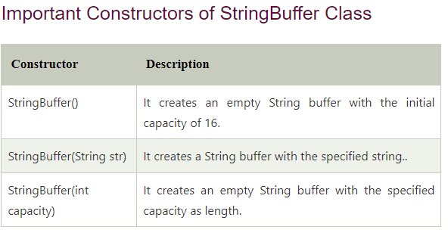
String Buffer
Java StringBuffer class is used to create mutable (modifiable) String objects. The StringBuffer class in Java is the same as String class except it is mutable i.e. it can be changed.

Slide 5
String Buffer
What is a mutable String?
A String that can be modified or changed is known as mutable String. StringBuffer and StringBuilder classes are used for creating mutable strings.

Slide 6
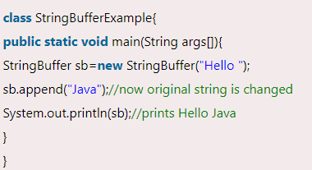
String Buffer
StringBuffer Class append() Method
The append() method concatenates the given argument with this String.

Slide 7
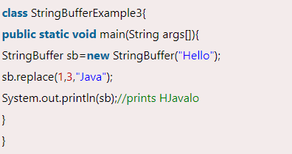
String Buffer
StringBuffer replace() Method
The replace() method replaces the given String from the specified beginIndex and endIndex.

Slide 8
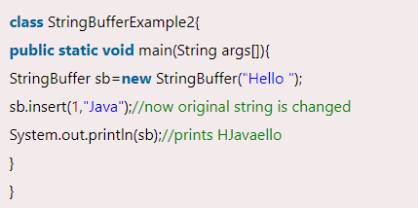
String Buffer
StringBuffer insert() Method
The insert() method inserts the given String with this string at the given position.

Slide 9
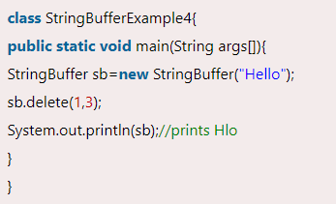
String Buffer
StringBuffer delete() Method
The delete() method of the StringBuffer class deletes the String from the specified beginIndex to endIndex.

Slide 10
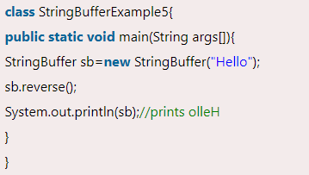
String Buffer
StringBuffer reverse() Method
The reverse() method of the StringBuilder class reverses the current String.

Slide 11
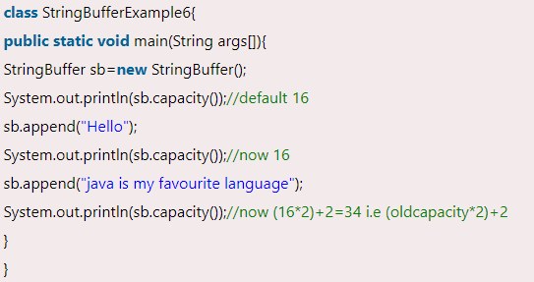
String Buffer
StringBuffer capacity() Method
The capacity() method of the StringBuffer class returns the current capacity of the buffer. The default capacity of the buffer is 16. If the number of character increases from its current capacity, it increases the capacity by (oldcapacity*2)+2. For example if your current capacity is 16, it will be (16*2)+2=34.

Slide 12
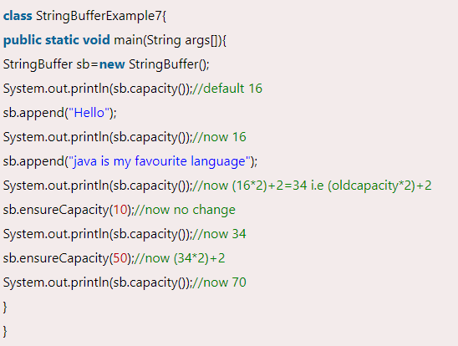
String Buffer
StringBuffer ensureCapacity() method
The capacity() method of the StringBuffer class returns the current capacity of the buffer. The default capacity of the buffer is 16. If the number of character increases from its current capacity, it increases the capacity by (oldcapacity*2)+2. For example if your current capacity is 16, it will be (16*2)+2=34.

Slide 13
String Buffer
More StringBuffer functions:
https://www.javatpoint.com/StringBuffer-class

Slide 14
Any Question
THANK YOU ☺

